Slide 1
The Scientific Method
Evaluating Representation in Science through a Peer-Reviewed Research Study

Slide 2
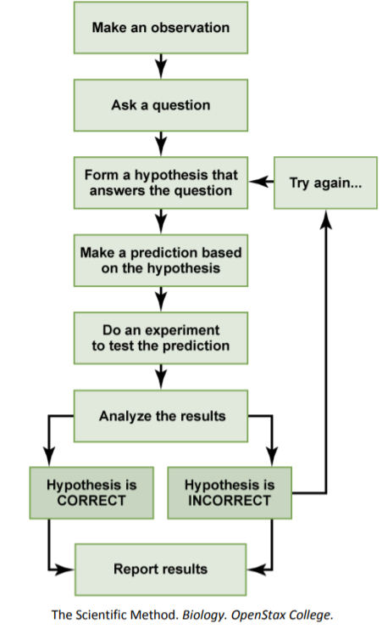
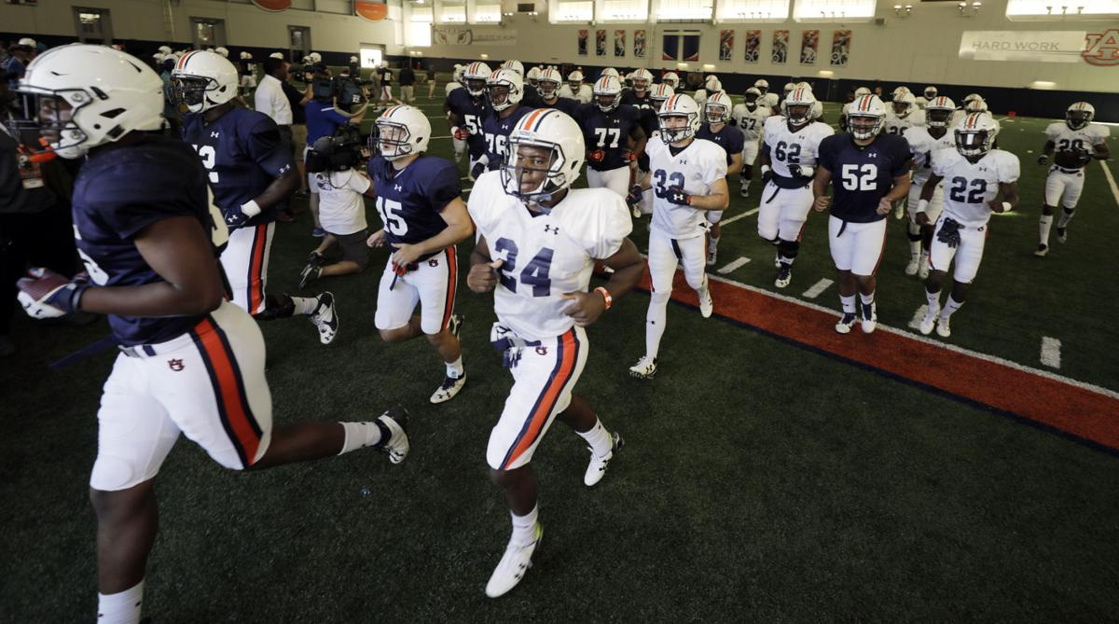
What is the scientific method?
“Practice makes perfect” mindset lead to pre-season football practices increase from 1 practice per day to 3 practices per day.

Slide 3
What is the scientific method?
Observation: Description, measurement or record of any object of phenomenon
Ask a Question: Expand on the current knowledge base
“Practice makes perfect” mindset lead to pre-season football practices increase from 1 practice per day to 3 practices per day.
Does increased practice increase win percentage?
Notes:
It is easy to identify a deer as male when you see his huge antlers, or a peacock as male by his stunning set of colorful tail feathers. This process happens when females mate with males that they think have the sexiest traits.
rhesus macaques are mostly vegetarians, so they don’t need long canines for the same purpose as other meat-eating species that use them to catch prey. Second, male rhesus macaques often bare their teeth at other males when they are competing for mates. Females could see the long canines as a sign of good genes and may prefer to mate with that trait.

Slide 4
What is the scientific method?
Hypothesis: A statement that is an informed, logical, and plausible explanation for observations
Must be testable, refutable, supported (but not proven), and precise
Predictions: Often displayed as “if-then” statements
Increased number of daily practices increases win percentage.
If daily football practices are increase from one daily to three daily meetings, then the percentage of wins will increase.

Slide 5
What is the scientific method?
Experiments: repeatable manipulation of one or more aspects of the natural world
Independent Variable: Manipulated… “if”
Dependent Variable: Responds to the manipulation… “then”
Control group: standard conditions; no change to independent variable
Treatment group: experimental groups; independent variable is manipulated; all other conditions the same as control group
If daily football practices are increased from one daily to three daily meetings, then the percentage of wins will increase.
Control: Teams continuing one practice a day
Treatment: Teams increasing to three practices a day

Slide 6
What is the scientific method?
We have results… now what?!

Slide 7
Limitations of Science
Can be applied only to the observable and measurable natural world
Cannot tell us what to do with the information it uncovers
Provides no help as to what is morally or ethically right or wrong
Can’t speak to existence of God or any supernatural events, distinguish beauty, or answer all questions
Science is a powerful tool… within its limits.

Slide 8
Pseudoscience
Observable and quantifiable
Clear and measurable hypothesis
Testable and falsifiable
Well designed and reproducible
Logical Conclusions
Peer-Review
Often cannot be seen or measured
Question often opposes existing facts and theories
Often cannot be quantified, observed or properly opposed
Not repeatable, anecdotal, or poorly described
Overstated conclusions drawn, beliefs stated as fact
Science
Often rejected in peer-review

Slide 9
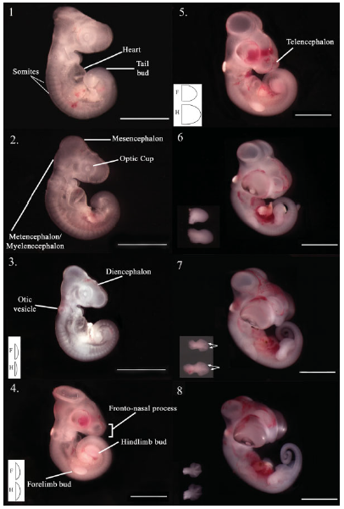
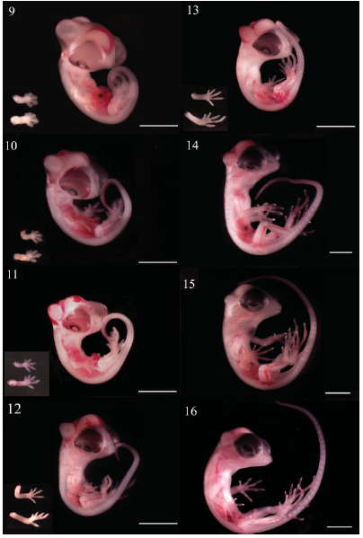
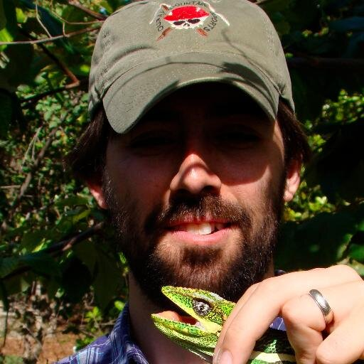
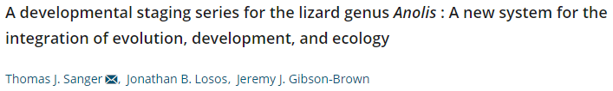
Types of scientific studies
Descriptive: Reporting data found in nature
This answers the “what”, but not the ”when”, “how”, or “why”
Notes:
Many fields in science began as descriptive fields… relying heavily on observations
One example is…
There are generally two common groupings. (1) Descriptive studies, and (2) Hypothesis-testing studies
Descriptive = “what”, hypothesis testing = “when”, “why”, “how”
Over time, we have become a hypothesis testing field. All of the following study types are hypothesis testing. However it is important to note that they also require observation. It is the additional of hypothesis-testing that sets them apart.

Slide 10
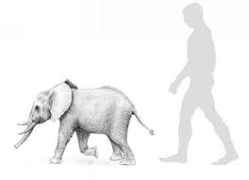
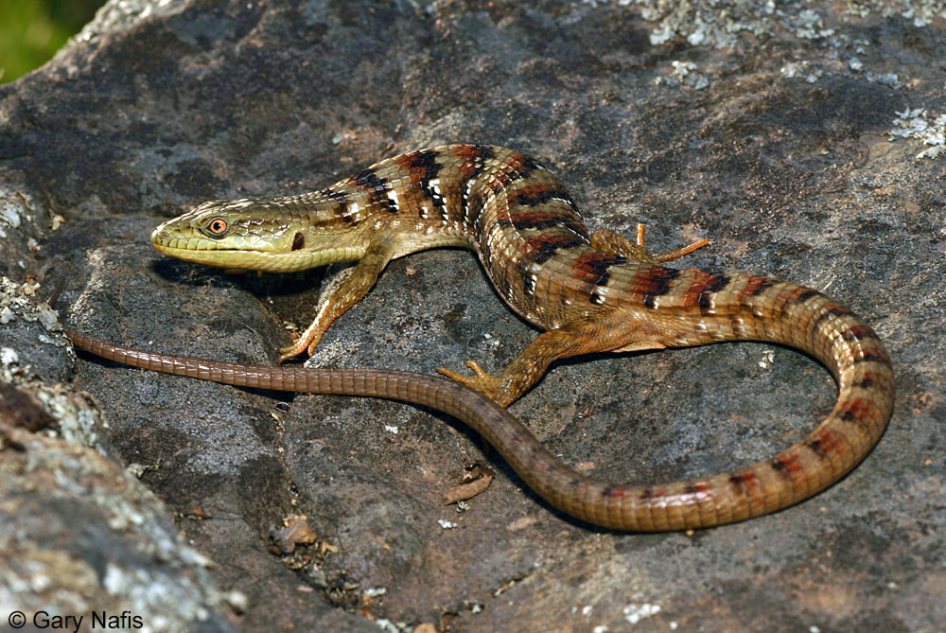
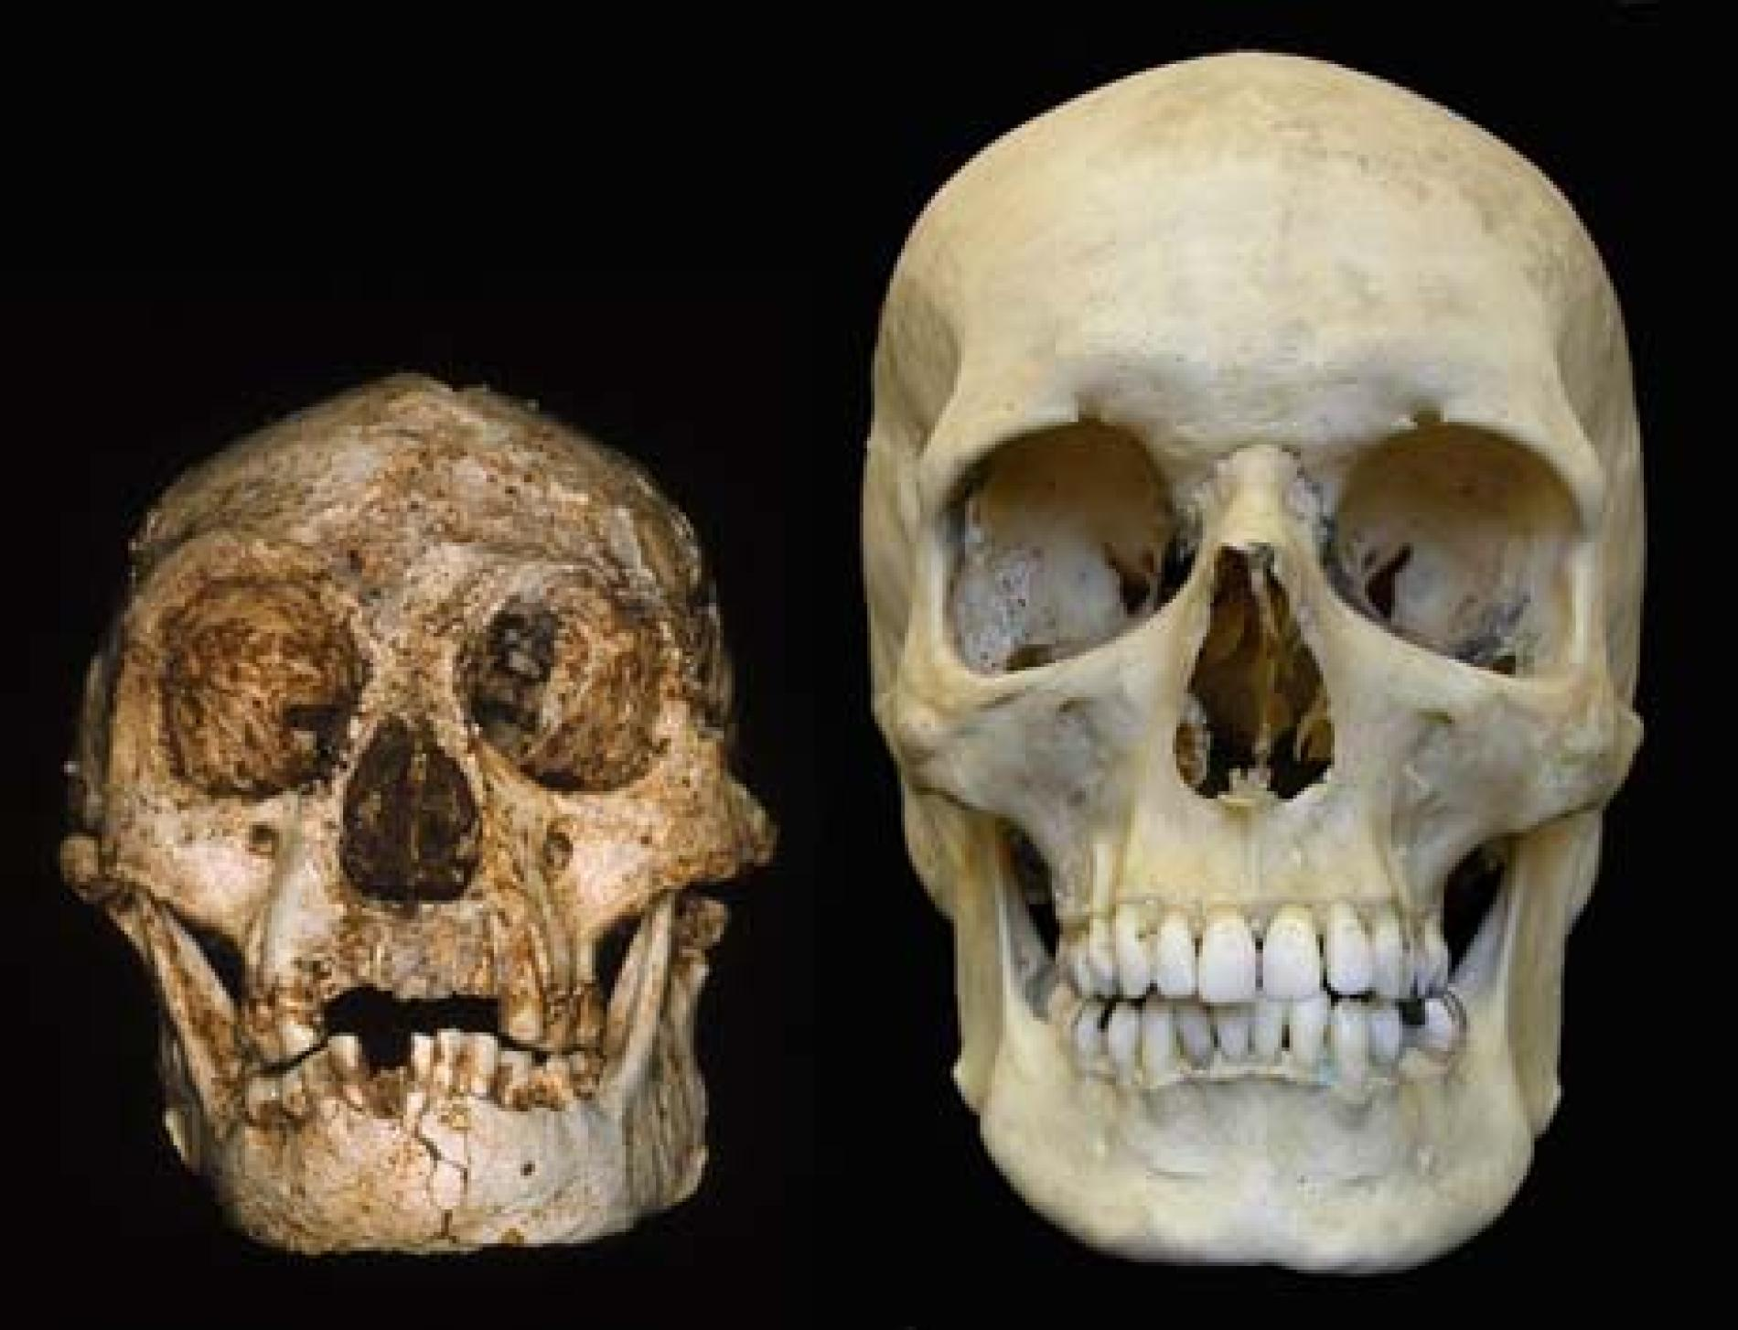
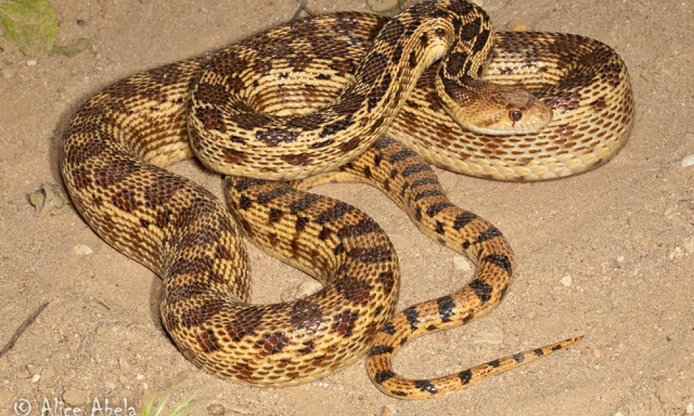
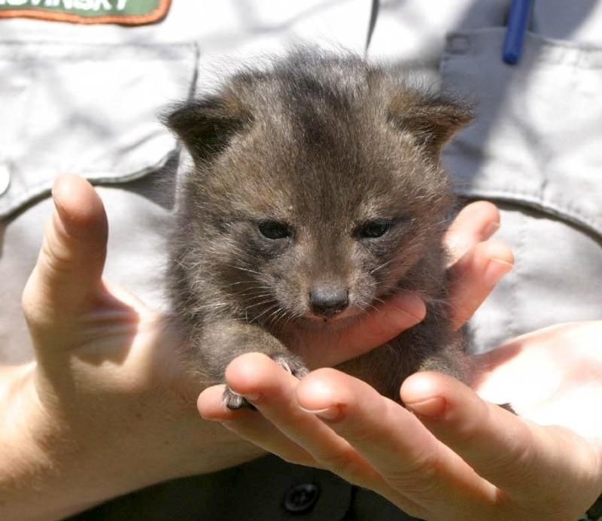
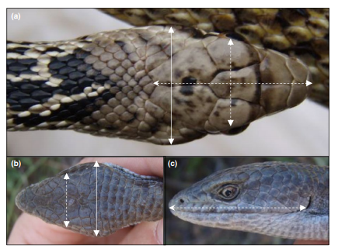
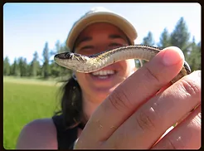
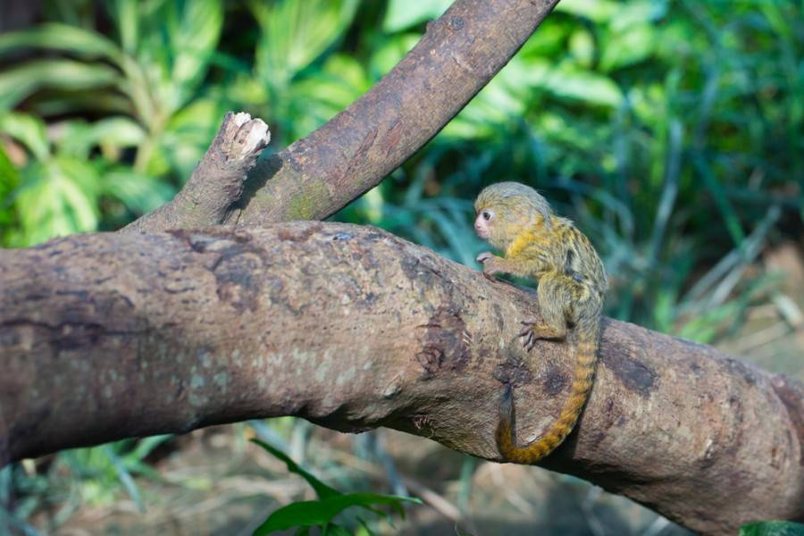
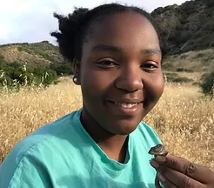
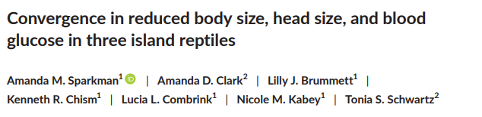
Types of scientific studies
Analytical: Looking for patterns in the data

Slide 11
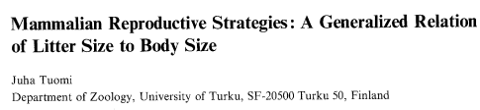
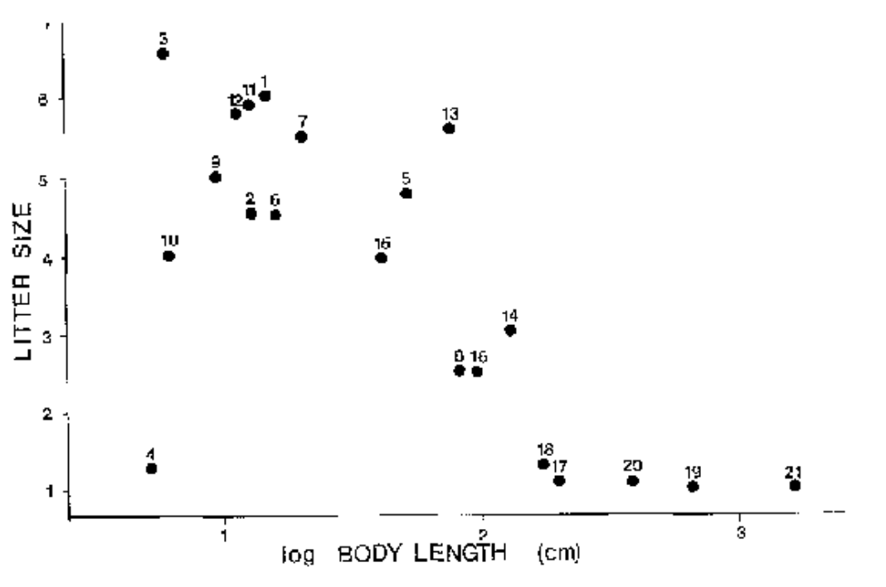
Types of scientific studies
Correlation: One or more parameters behaves in an interrelated manner
Notes:
To what degree… can not tell you causation. Correlations are statistics.

Slide 12
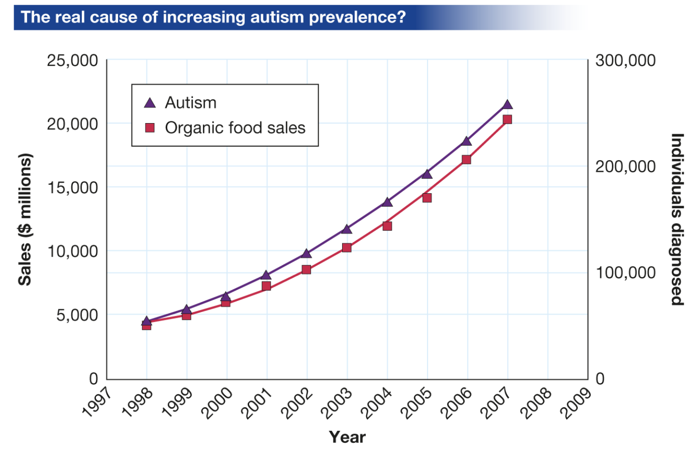
Correlation and Causation
Would you say that organic foods cause children to be born with autism?

Slide 13

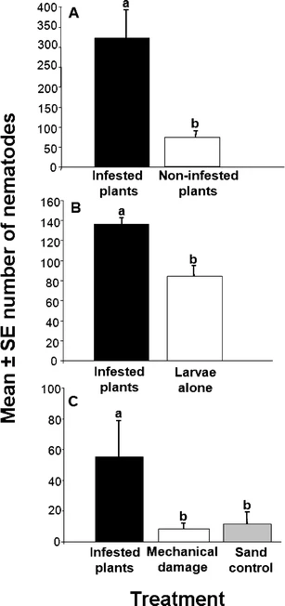
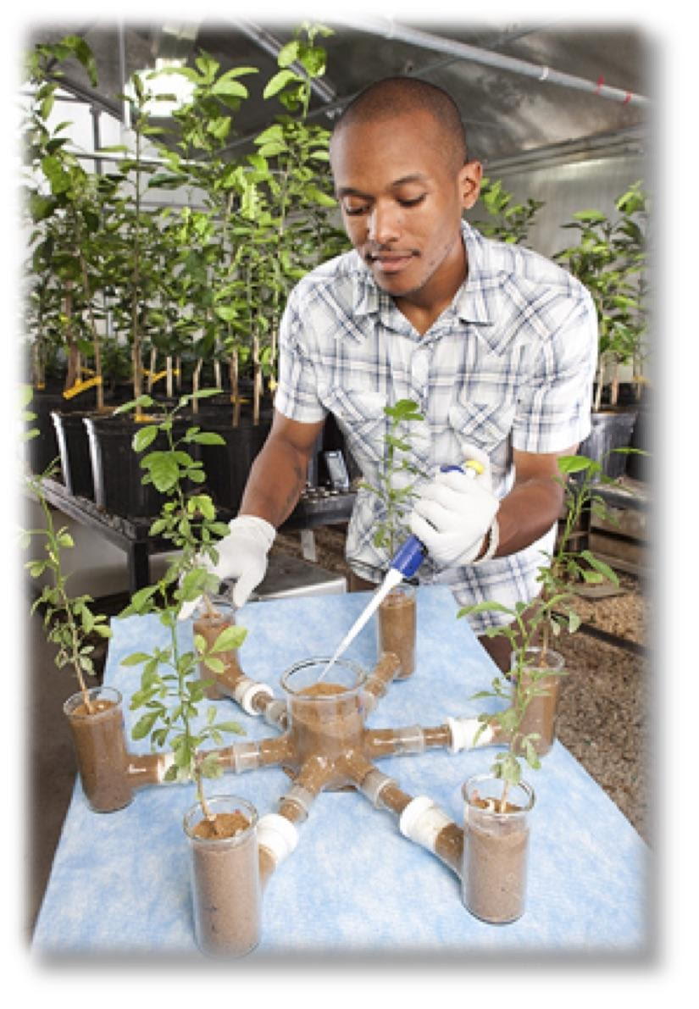
Types of scientific studies
Jared Ali
Experimental Causation: One parameter can be shown to cause the effect of the other
Ali, J. G., Alborn, H. T., & Stelinski, L. L. (2010). Subterranean herbivore-induced volatiles released by citrus roots upon feeding by Diaprepes abbreviatus recruit entomopathogenic nematodes. Journal of Chemical Ecology, 36(4), 361-368.
Notes:
We found that insect damaged roots could attract worms that would kill insect pests!
More insect parasitic worms (entomopathogenic nematodes, Y axis) were attracted to insect damaged roots. (A) We see that plants infested with root feeding insects attract more insect-killing nematodes. This trend continued as we found the nematodes preferred the insects feeding on roots over insects alone (B) and also more than plant roots damaged mechanically or blank soil (C).

Slide 14
Todays Activity
Evaluating Representation in Science through a Peer-Reviewed Research Study

Slide 15

Take the next 5 minutes in your group to read and discuss page one of your activity

Slide 16
Take the next 15 minutes in your group to fill in page two of your activity and discuss the prompt in number 2

Slide 17
Class discussion
What do these photos imply about the types of people who do science?

Slide 18
Take the next 10 minutes in your group to complete page 3 of your activity

Slide 19
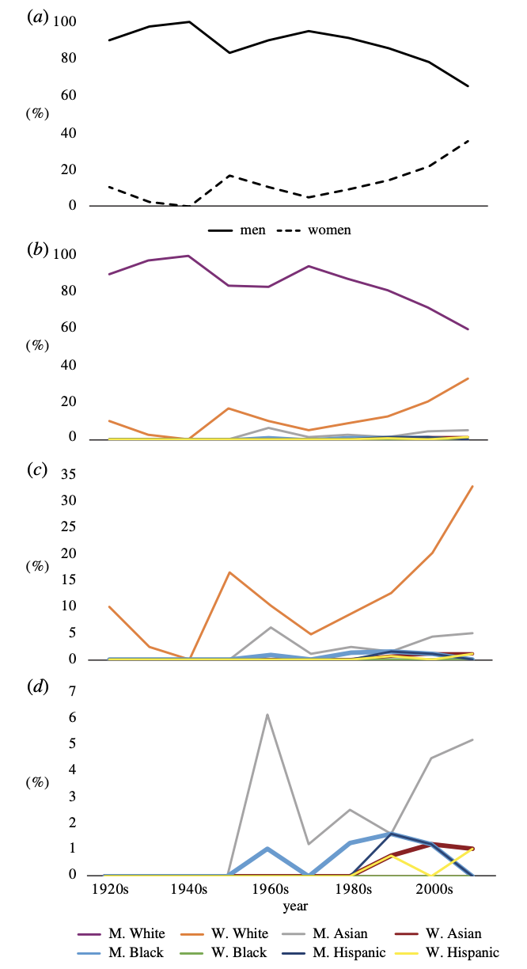
Wood et al 2020
Figure 1. Demographic representation of scientists featured in biology textbooks, shown as proportions over time of scientific discovery. (a) Representation of scientists in terms of binary gender. (b) Representation of scientists in terms of binary gender and race. The majority of highlighted scientists were White men ( purple line) and White women (orange line). (c,d) We increased resolution of the data by removing White men and then White women, respectively; (d) shows the values of scientists of colour featured (grey line: Asian men; red line: Asian women; light blue line: Black men; green line: Black women; navy blue line: Hispanic men; yellow line: Hispanic women).

Slide 20
Take the next 15 minutes in your group to complete page 4 of your activity

Slide 21
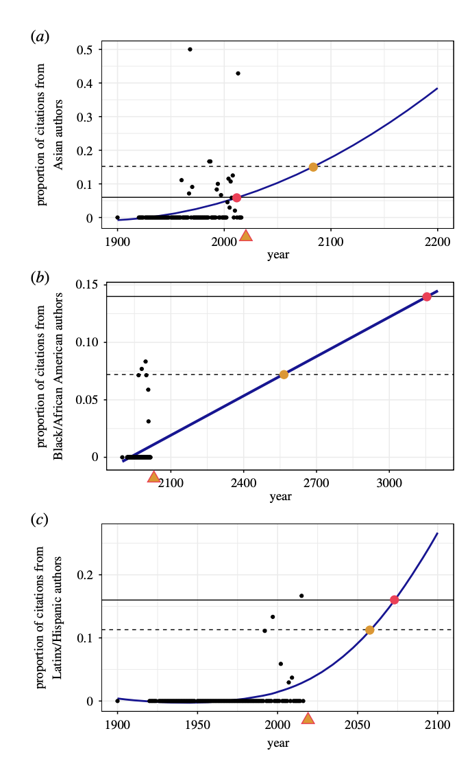
Wrap it up
Why does this matter?
What are the implications for:
Students
Society
Science
Figure 4. An extrapolation of Asian (a), Black/African American (b) and Latinx/ Hispanic (c) scientists as a function of year with best fit lines. In these projections, trends in representation in textbooks are extrapolated from the current (orange triangle) to the future. Best fit lines estimate when textbook representation of these groups will reflect that of the general population (solid horizontal line, red dot) and the population of biology undergraduates (dashed horizontal line, orange dot).

